Slide 1

Mirror Detection in Videos
Iain High

Slide 2
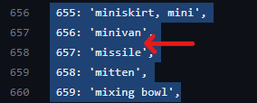
Motivation
Mirrors and reflective surfaces appear everywhere around us.
Despite their significance, they are absent from major object detection and semantic segmentation datasets such as ImageNet, CIFAR, and COCO.
Partially because of the absence in major datasets, and partially because of the nuanced complexity of reflections – Mirrors significantly impact CV tasks.
E.g. Mirrors were identified to be one of the six primary error sources in person detection.

Slide 3
Task
Because of the reasons mentioned previously, mirror detection is of crucial importance to CV.
Custom models specifically for detecting mirrors are required because of reflections are usually not
Moreover, the reason for focusing on videos opposed to images is because many real-world vision applications are video-based.
Robotic Navigation
Autonomous Driving
Surveillance
Hence, we want to create a model which is able to detect mirrors in videos.

Slide 4
Related Work
Mirror Detection in Images:
Majority of mirror detection focuses on identifying mirrors in single images.
MirrorNet – Utilises Contextual Contrast
SANet – Semantic Associations
Mirror-YOLO: YOLO approach to mirror detection
VCNet: Visual chirality
Mirror Detection in Videos:
Only one existing model which addresses mirror detection in videos – VMD-Net
Uses intra-frame and inter-frame correspondences to detect mirrors in videos.
SOTA model which ours will build upon and compare against.
Outperforms all image mirror detection models.

Slide 5
Our Approach
All videos in the current VMD dataset are very similar to each other.
Because of this the model doesn’t adapt well to videos containing mirrors from different situations.
To resolve this issue, we propose a modified model which uses a semi-supervised training approach.

Slide 6
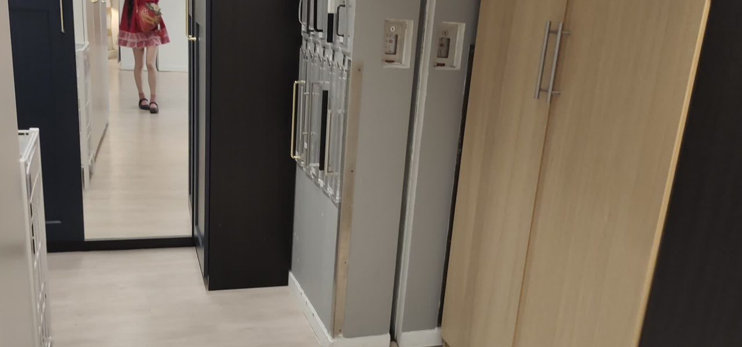
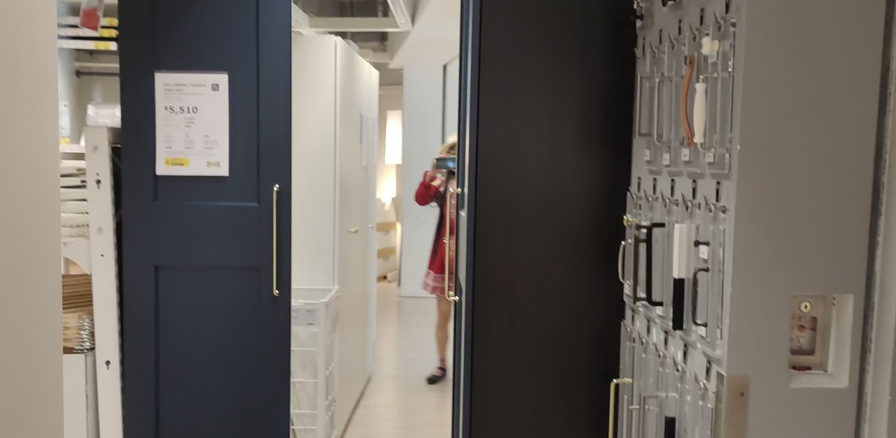
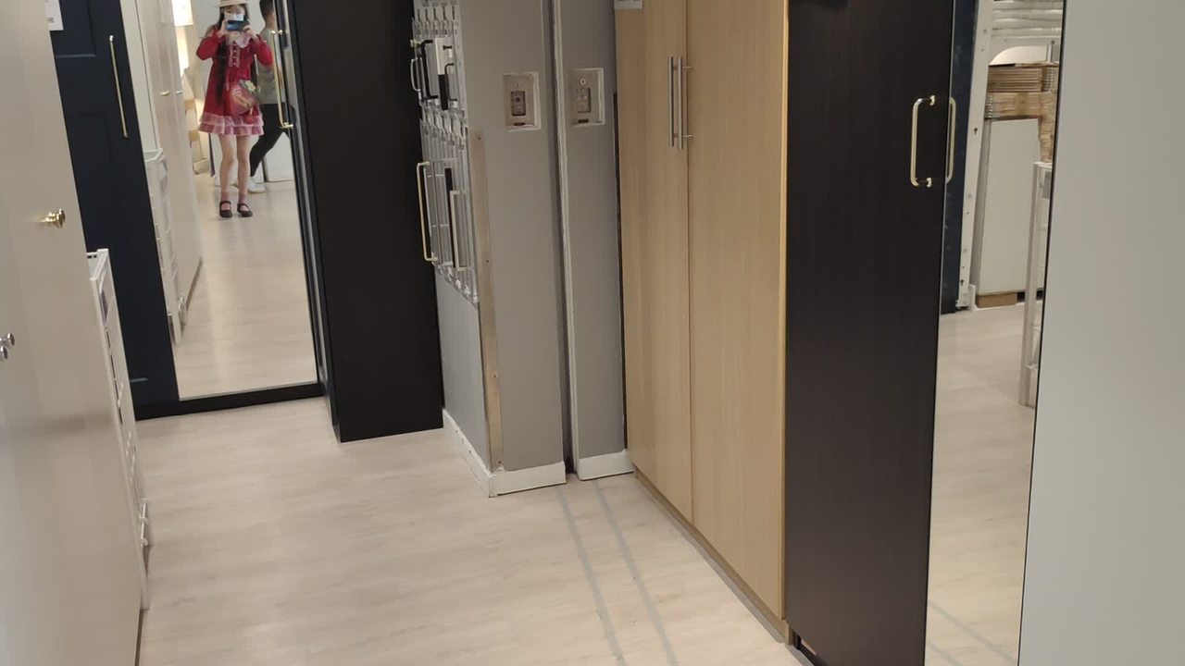
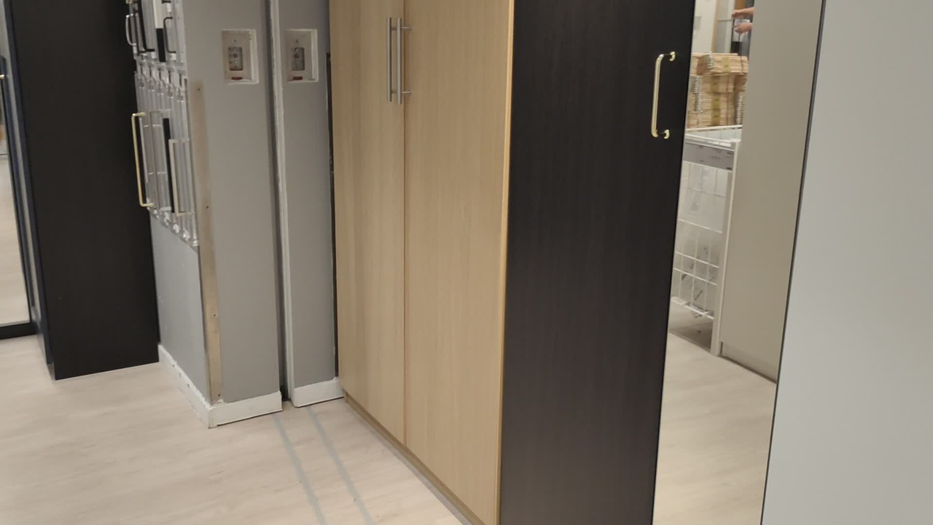
Existing Dataset
Existing Dataset:
Video Mirror Detection released an annotated dataset consisting of 269 videos, and a total of 14,987 frames.
The data is all similar – The mirror is mainly in the foreground, visible for the entire duration of the video, videos are taken from two different environments – one household and one in a furniture store.

Slide 7
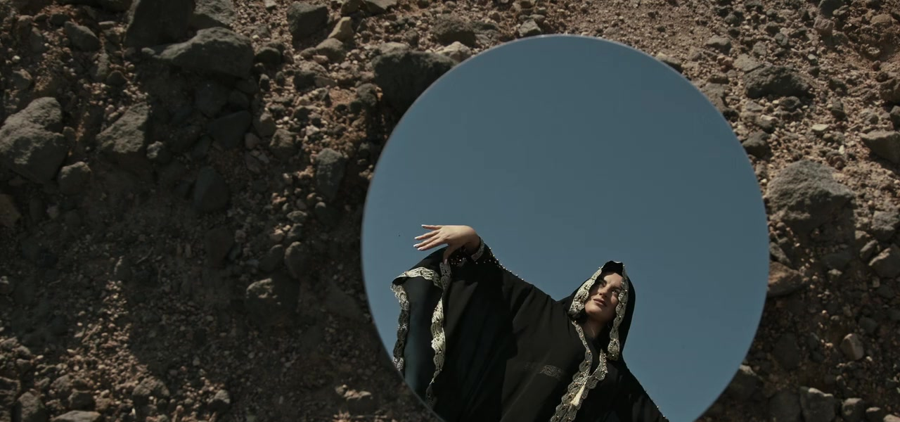
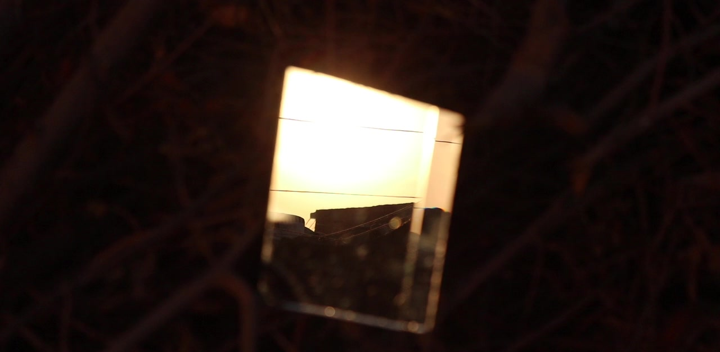
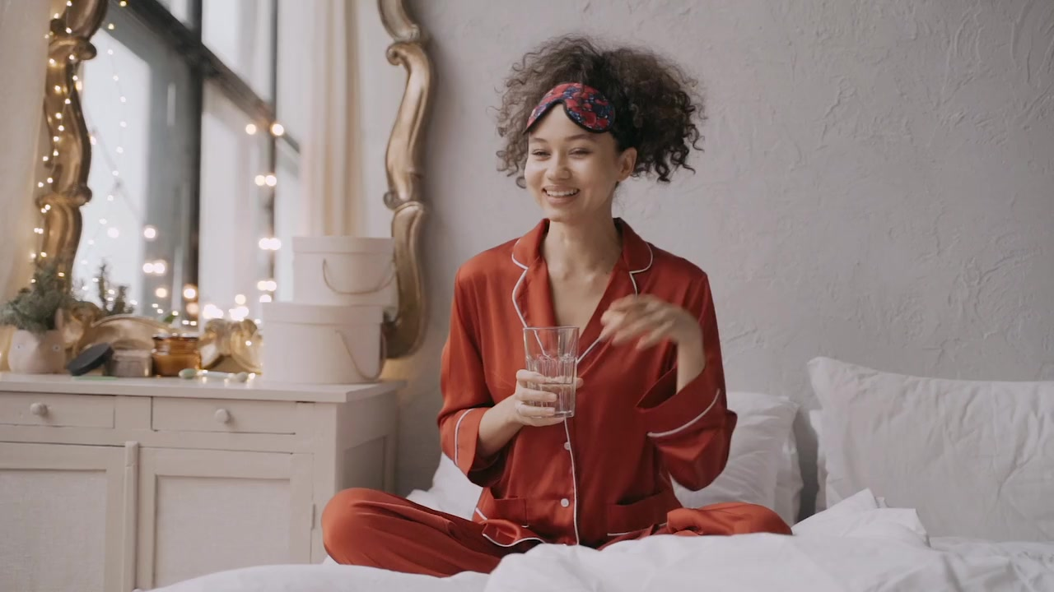
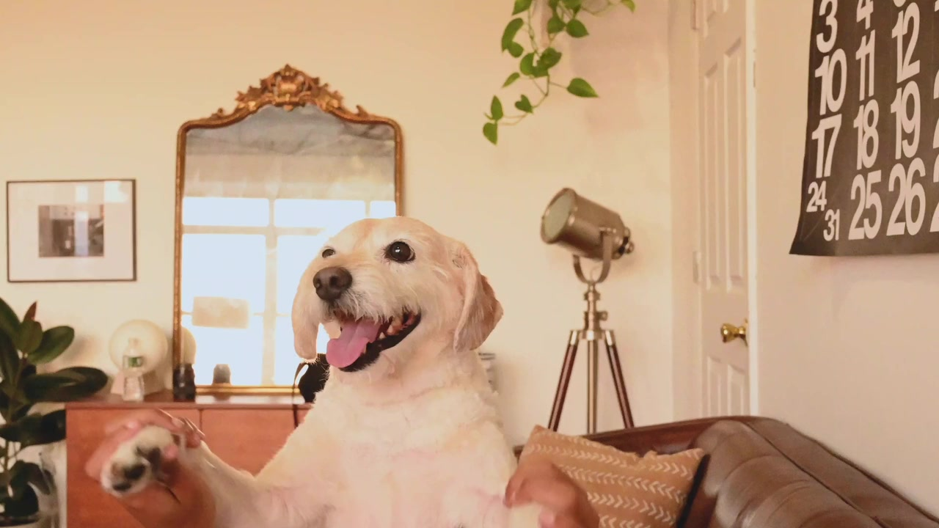
New Dataset
Two new datasets were made for this project
Annotated Dataset
After noticing how similar the images in VMDD were, a new annotated dataset was created to how well the existing model would adapt.
It’s a very small dataset – consisting of just over 1,000 frames - and so isn’t used for training, just for testing adaptability.
Unannotated Dataset
A much larger unannotated dataset was also created using the Pexels API to gather 600 videos each containing a mirror. Total number of frames is
A lot more diverse environments, situations, and video lengths than the VMDD dataset.
Used for implementing a semi-supervised approach to mirror detection.

Slide 8
Evaluation
Our model will be evaluated on both the existing VMD-dataset dataset as well as our new Pexels annotated dataset.
Since there is only one existing video mirror detection model, ours will be compared to this SOTA technique.
Evaluation Metrics:
We will evaluate our model in terms of:
Accuracy
IOU (Intersection Over Union)
F1
MAE (Mean Absolute Error)
BER (Balanced Error Rate)

Slide 9
Progress
Lots of attempted modifications which had little/no improvement current SOTA:
Attempts to expand amount of annotated data: Omnidata & Computer Rendered Images.
Using the RGB difference between consecutive frames as input to the model (similar idea to using optical flow information).
Using all ResNext layers (opposed to just one low and one high level feature).
Semi-Supervised Approach:
Created small annotated dataset to analyse adaptability.
Created large unannotated dataset using the Pexel API to use for semi-supervised.
Implemented self-training and EM model.
Tested these models with different confidence thresholds and start iterations.

Slide 10
Preliminary Results
Our semi-supervised model has already made a small improvement over the SOTA model. As can be seen by the results below:
Model | VMDD-Test Accuracy | VMDD-Test MAE | Annotated Pexel Accuracy | Annotated Pexel MAE
VMDD (SOTA) | 0.868 | 0.132 | 0.807 | 0.193
Self-Learning Model | 0.895 | 0.105 | 0.834 | 0.166
EM Model | WIP* | WIP* | WIP* | WIP*
* Submitted the EM model to train on Eddie yesterday, hoping it would get results before this presentation!

Slide 11
Going Forward
Short Term (Next few Weeks)
Get results from the EM approach and compare to self-learning.
Possibly rethink how the confidence for predictions is calculated.
Look into other types of Semi-supervised approaches for video segmentation.
Quantise the similarity of videos in the VMD dataset compared to the new unannotated (Sum Squared Differences / Mutual Information / Cross Correlation).
Continued Refinement of self-supervised approach – testing different confidence thresholds + start iteration for the self-supervised step.
Long Term (>4 Weeks)
After the FLW, focus will be on writing the final report.
Project Day on Wednesday 13th March.
Dissertation Deadline 4th April.

